Slide 1

Practical Use of
WCAG Guidelines
Notes:
In this ppt we will study about Use of WCAG Guidelines.
Web Content Accessibility Guidelines (WCAG), explains how to make web content more accessible to people with disabilities. WCAG covers web sites, applications, and other digital content. It is developed by the World Wide Web Consortium (W3C) Web Accessibility Initiative (WAI). WCAG is an international standard.
There are three levels of conformance:
Level A is the minimum level.
Level AA includes all Level A and AA requirements. Many organizations strive to meet Level AA.
Level AAA includes all Level A, AA, and AAA requirements.
In our Accessibility course, we have learnt WGAG Guidelines but it is important to ensure that we are correctly interpreting the guidelines ourselves, to not identify false positive or false negatives.
Accessibility makes a difference in the lives of real people. Whenever possible, we should think through the full implications of our designs, and not just the technical accessibility, and feel free to incorporate WCAG level AAA ideas into our site, and to even go beyond WCAG to incorporate best practices for disability usability.
We must be consistent and accurate in interpreting what is and what is not a failure of WCAG.
For each WCAG Guidelines, Success Criteria (SC) are written as testable statements that are not technology-specific. For each WCAG Success Criteria, we will find the interpretation in form of Checkpoints.
These Checkpoints are a proven method for accessibility requirements testing and help reviewers produce consistent and accurate test results during accessibility assessments.

Slide 2
WCAG 2.1 Guidelines
Perceivable - web content is made available to the senses
Information and user interface components must be presentable to users in ways they can perceive.
Operable - interface forms, controls, and navigation are operable
User interface components and navigation must be operable.
Understandable - content and interface are understandable
Information and the operation of user interface must be understandable.
Robust - content can be used reliably by a wide variety of user agents, including assistive technologies
Content must be robust enough that it can be interpreted by a wide variety of user agents, including assistive technologies.
Notes:
WCAG Guidelines has 4 Principles- P-O-U-R :
Perceivable – Web content is made available to the senses.
Information and user interface components must be presentable to users in ways they can perceive.
Operable – interface forms, controls, and navigation are operable.
User interface components and navigation must be operable.
Understandable - content and interface are understandable.
Information and the operation of user interface must be understandable.
Robust - content can be used reliably by a wide variety of user agents, including assistive technologies.
Content must be robust enough that it can be interpreted by a wide variety of user agents, including assistive technologies.

Slide 3
WCAG 2.1 Guidelines
Perceivable - web content is made available to the senses
Sr. No. | Context | Guideline
1.1 | Text Alternatives | Provide text alternatives for non-text content (e.g. images)
1.2 | Time‐based Media | Provide alternatives for time-based media (audio and video)
1.3 | Adaptable | Content can be presented in different ways (e.g. through a screen reader) without losing info or structure
1.4 | Distinguishable | Make sure content is readable and the foreground contrasts sufficiently with the background
Notes:
Information and user interface components must be presentable to users in ways they can perceive.
Reference:
https://www.w3.org/TR/WCAG21/#perceivable

Slide 4


WCAG 2.1 Guidelines
1.1 Text Alternatives - Provide text alternatives for non-text content (e.g. images)
Case: Providing Alternative texts
Notes:
Now, we will have look on , Guideline 1.1 Text Alternatives. Provide text alternatives for non-text content (e.g. images)
(Level A)
Provide text alternatives for any non-text content and should serve the equivalent purpose.

Slide 5
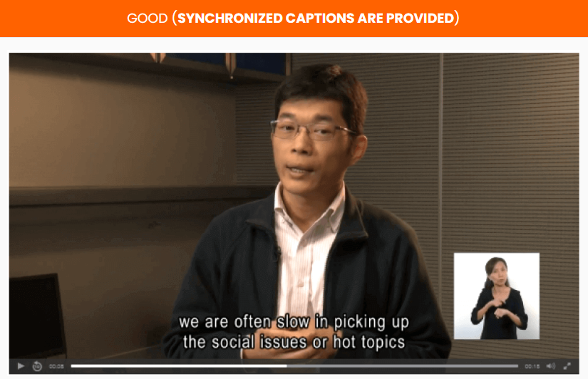

WCAG 2.1 Guidelines
1.2 Time‐based Media - Provide alternatives for time-based media (audio and video)
Case: Providing caption for media content
Notes:
Now, we will have look on , Guideline 1.2 Time-based Media.
Provide alternatives for time-based media.
(Level A)
Provide an alternative for time-based media that presents equivalent information for prerecorded audio-only or video-only content.
Provide an alternative for time-based media for synchronized media.
Provide captions for all prerecorded audio content in synchronized media.

Slide 6
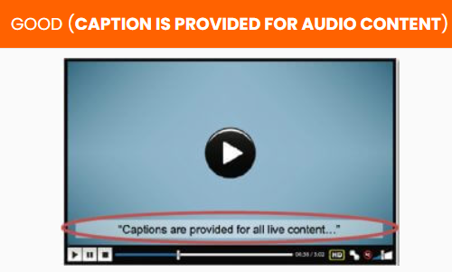
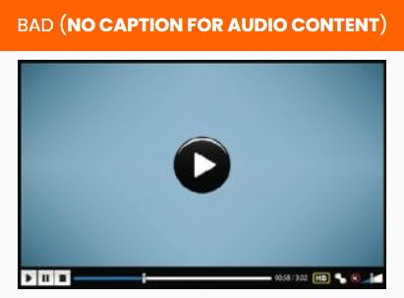
WCAG 2.1 Guidelines
1.2 Time‐based Media - Provide alternatives for time-based media (audio and video)
Case: Providing caption for live audio content
Notes:
(Level AA)
Provide captions for all live audio content in synchronized media.
Provide an audio description for all prerecorded video content in synchronized media.

Slide 7

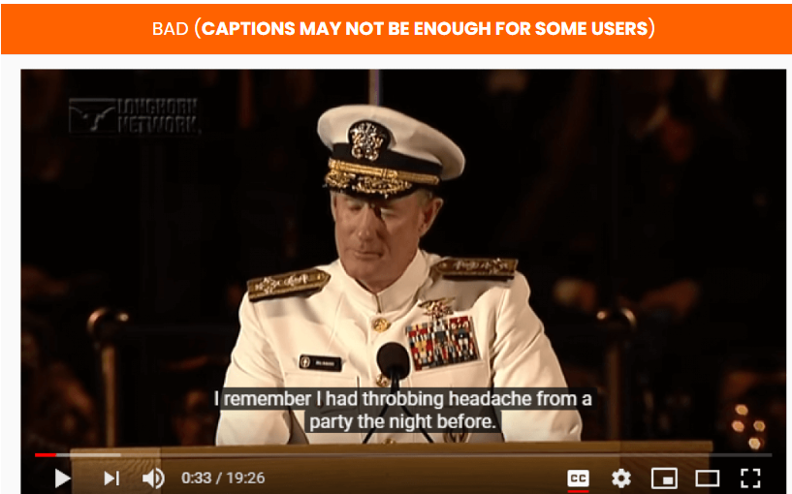
WCAG 2.1 Guidelines
1.2 Time‐based Media - Provide alternatives for time-based media (audio and video)
Case: Providing sign language interpretation for audio content
Notes:
(Level AAA)
Provide sign language interpretation for all prerecorded audio content in synchronized media.
Provide an extended audio description for all prerecorded video content in synchronized media when audio descriptions can’t convey the sense of the video.
Also, provide an alternative for time-based media for all prerecorded video-only media.
Provide an alternative for time-based media that presents equivalent information for live audio-only content.

Slide 8
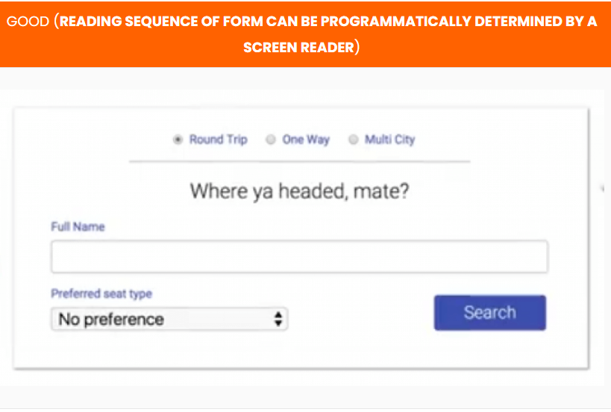
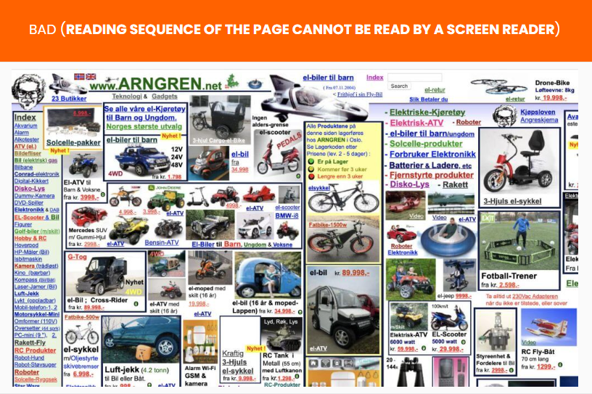
WCAG 2.1 Guidelines
1.3 Adaptable - Content can be presented in different ways (e.g. through a screen reader) without losing info or structure
Case: Web page with reading sequence
Notes:
Now, we will have look on , Guideline 1.3 Adaptable.
Create content that can be presented in different ways (e.g simpler layout), without losing information or structure.
(Level A)
Ensure information conveyed through presentation can be programmatically determined, or, are available in text.
Ensure a correct reading sequence can be programmatically determined.
Instructions provided for operating content should not rely solely on shape or sound.

Slide 9
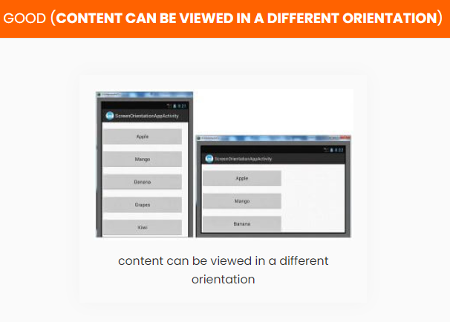
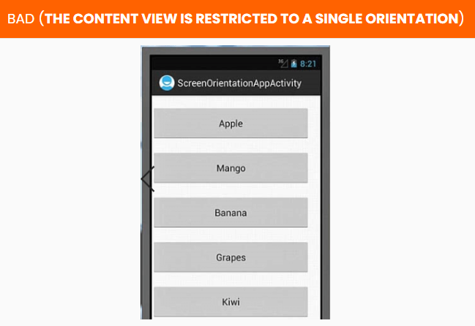
WCAG 2.1 Guidelines
1.3 Adaptable - Content can be presented in different ways (e.g. through a screen reader) without losing info or structure
Case: Display orientation
Notes:
(Level AA)
Don’t restrict content view and operation to a single display orientation (portrait or landscape), unless a specific display orientation is essential.
The purpose of each input field collecting information about the user should be easily identifiable.

Slide 10
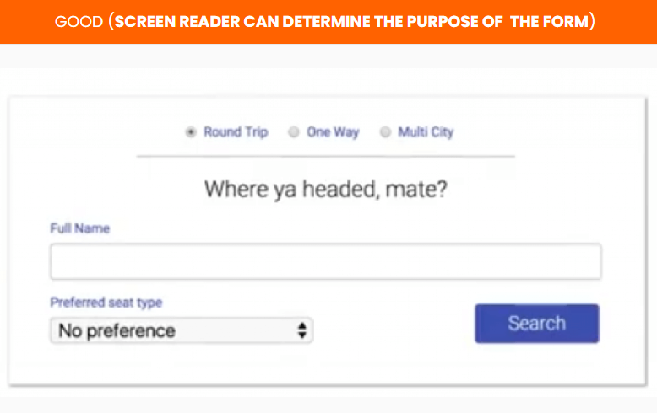
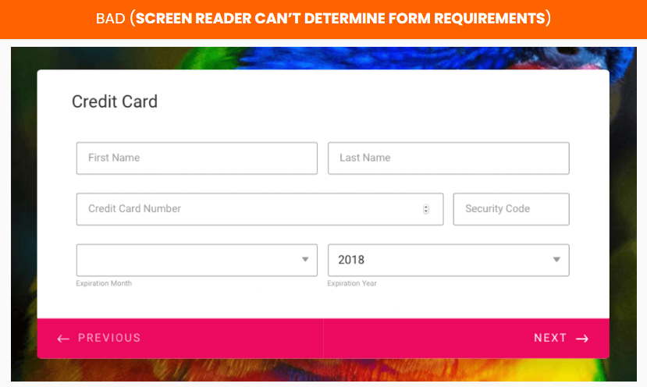
WCAG 2.1 Guidelines
1.3 Adaptable - Content can be presented in different ways (e.g. through a screen reader) without losing info or structure
Case: Programmatically determinable web pages
Notes:
Level AAA
Ensure the purpose of User Interface components, icons, and regions can be programmatically determined

Slide 11
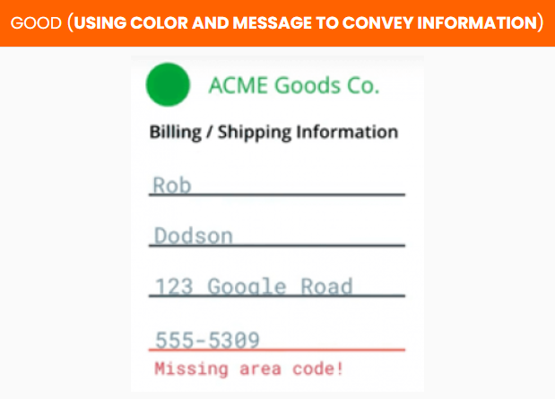
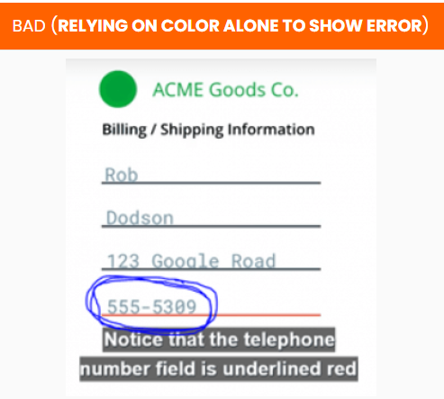
WCAG 2.1 Guidelines
1.4 Distinguishable - Make sure content is readable and the foreground contrasts sufficiently with the background)
Case: Usage of color as a visual means to convey information
Notes:
Now, we will have look on , Guideline 1.4 Distinguishable.
Content should be easy for users to see and hear. More so, separate foreground from background.
Level A
Color should not be used as the only visual means of conveying information.
Provide a mechanism for controlling audio volume independently from the overall system volume level for any audio on the web page.

Slide 12
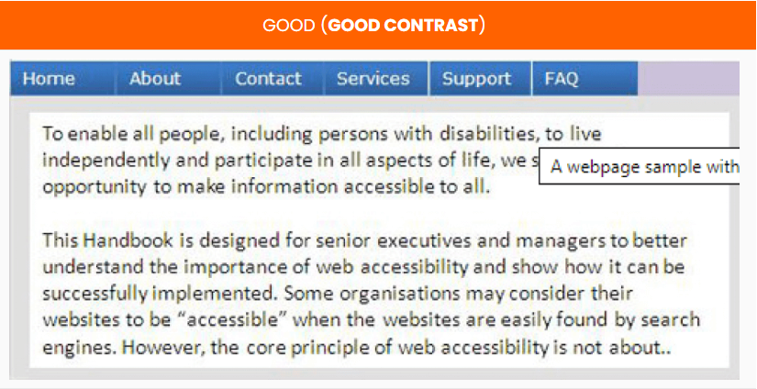
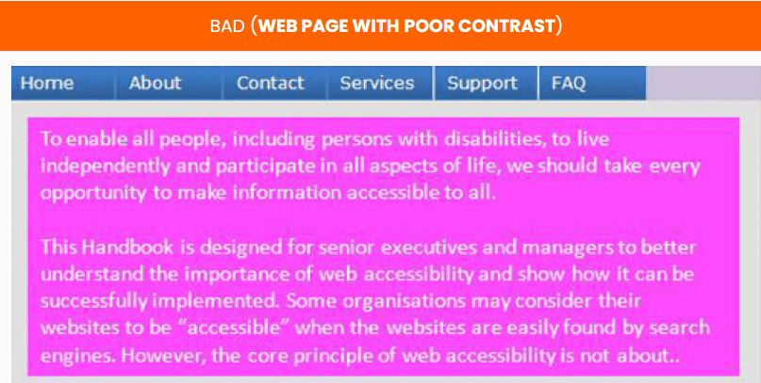
WCAG 2.1 Guidelines
1.4 Distinguishable - Make sure content is readable and the foreground contrasts sufficiently with the background
Case: Color contrast
Notes:
Level AA
Contrast ratio should be at least 4.5:1 for normal text and at least 3:1 for large-scale visual presentation.
Ensure text can be resized without assistive technology up to 200 percent without loss of content or functionality.
Convey information through text rather than images of text if the technologies being used can achieve the visual presentation.
Ensure content can be presented without loss of information or functionality, and without horizontally and vertically scrolling.
The contrast ratio should be 3:1 for User Interface components and graphical objects in visual presentation.
Ensure no loss of content or functionality occurs by changing style property e.g spacing.
Where keyboard focus triggers additional content to become visible and then hidden, provide a mechanism to dismiss the additional content.

Slide 13
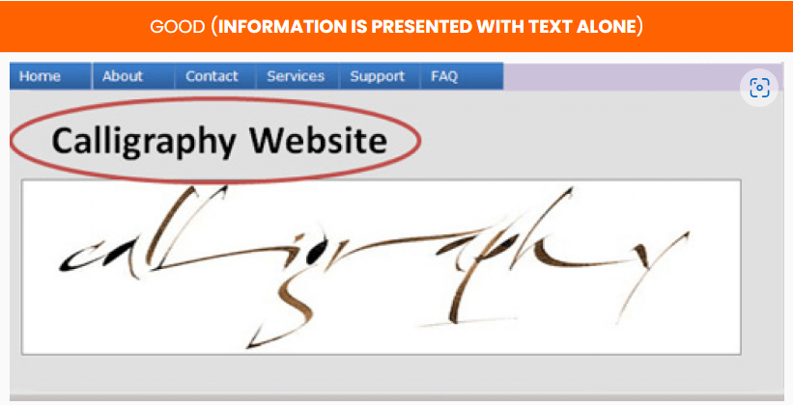
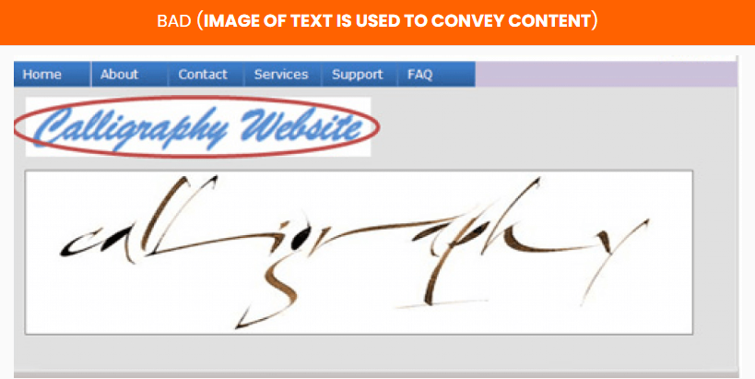
WCAG 2.1 Guidelines
1.4 Distinguishable - Make sure content is readable and the foreground contrasts sufficiently with the background
Case: Conveying information
Notes:
(Level AAA)
Contrast ratio should be at least 7:1 for text and images of text and 4.5:1 for large text in visual presentation.
Ensure audio contain very low or no background sounds.
For the visual presentation of blocks of text, provide a mechanism for selecting styling and spacing of the text.
Images of text should only be used for decoration or conveying essential information.

Slide 14
WCAG 2.1 Guidelines
Operable - interface forms, controls, and navigation are operable
Sr. No. | Context | Guideline
2.1 | Keyboard Accessible | Make all functionality available from a keyboard
2.2 | Enough Time | Give users enough time to read and use content
2.3 | Seizures | Do not use content that can cause seizures
2.4 | Navigable | Help users to navigate, find content, and determine where they are
2.5 | Input Modalities | Make it easier for users to operate functionality through various inputs beyond keyboard
Notes:
User interface components and navigation must be operable.
Reference:
https://www.w3.org/TR/WCAG21/#operable

Slide 15
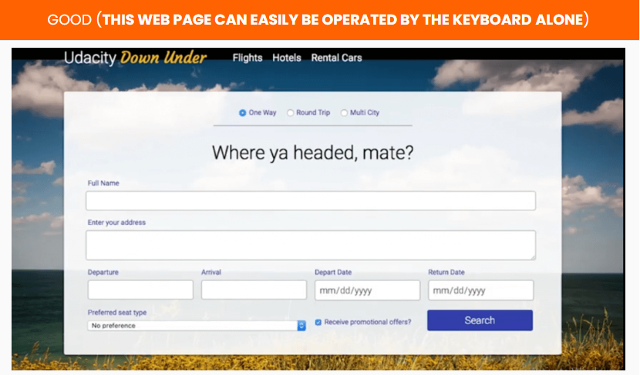
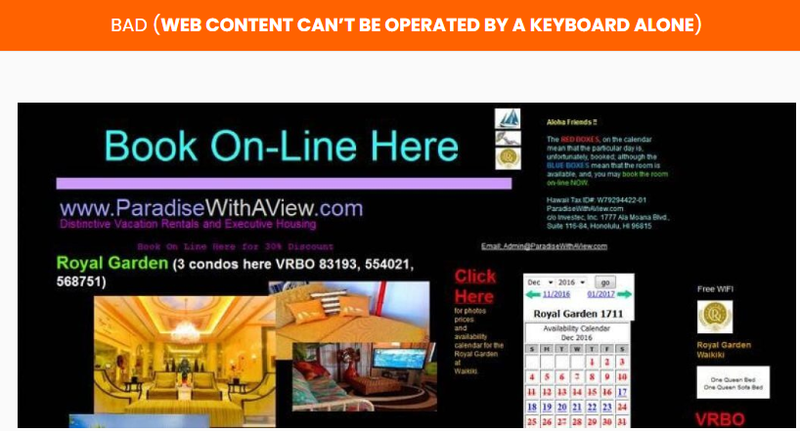
WCAG 2.1 Guidelines
2.1 Keyboard Accessible - Make all functionality available from a keyboard
Case: Keyboard operable web pages
Notes:
Now, we will have look on , Guideline 2.1 Keyboard Accessible.
Make all functionality available from a keyboard.
(Level A)
Ensure all functionality of the content is operable through a keyboard interface, except where the function requires input that depends on the user’s movement.
Ensure focus can be moved to and away from a component of the page using a keyboard interface.
Provide a mechanism for on and off keyboard shortcuts implemented in content.
(Level AAA)
Ensure all functionality of the content is operable through a keyboard interface without requiring specific timings for individual keystrokes.

Slide 16
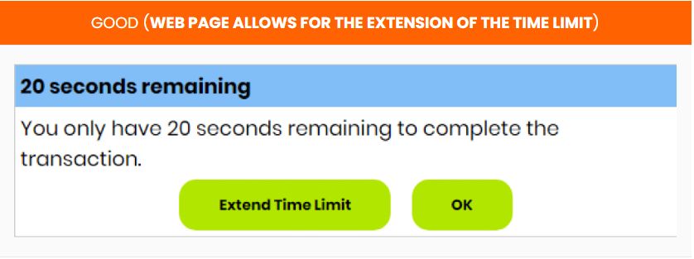
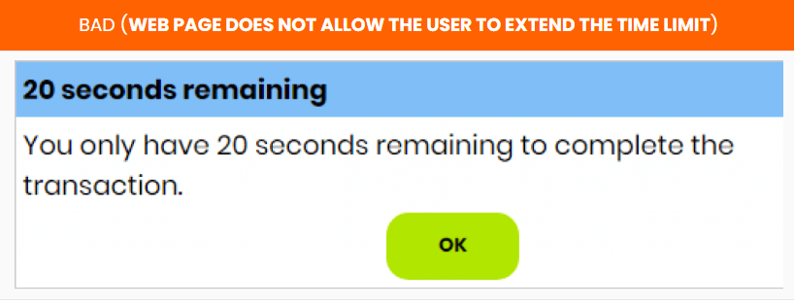
WCAG 2.1 Guidelines
2.2 Enough Time - Give users enough time to read and use content
Case: Web pages with time to read and use the content
Notes:
Now, we will have look on , Guideline 2.2 Enough Time.
Provide users enough time to read and use the content.
(Level A)
Ensure that users can complete tasks without unexpected changes in content or context that are a result of a time limit.
For moving, blinking, scrolling, or auto-updating information, ensure there is a mechanism for the user to pause, stop, hide the movement or to control the frequency of the update.

Slide 17
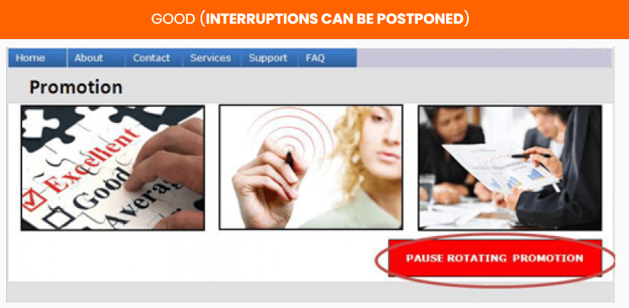
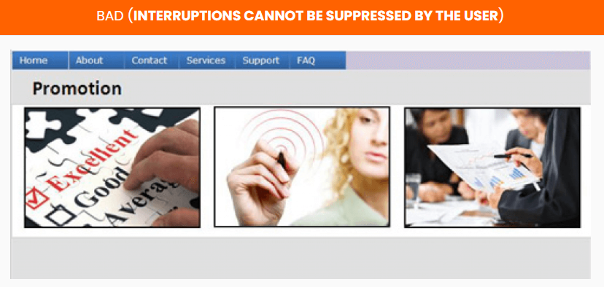
WCAG 2.1 Guidelines
2.2 Enough Time - Give users enough time to read and use content
Case: Web pages with interruptions
Notes:
(Level AAA)
Ensure timing is not an essential part of the event or activity presented by the content, except for non-interactive audio/video.
Ensure interruptions can be postponed or suppressed by the user, except interruptions involving an emergency.
When an authenticated session expires, ensure the user can continue without loss of data.
Ensure users are warned of the duration of any user inactivity that could cause data loss except data is preserved for more than 20 hours.

Slide 18

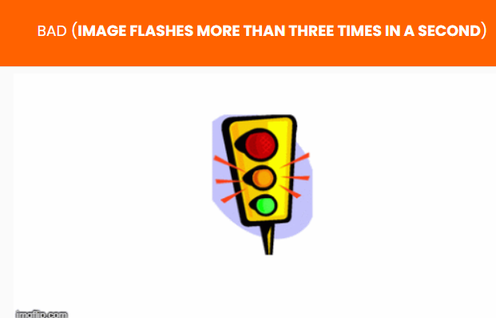
WCAG 2.1 Guidelines
2.3 Seizures - Do not use content that can cause seizures
Case: Web pages with flashes
Notes:
Guideline 2.3 Seizures
Do not design content in a way that is known to cause seizures or physical reactions.
(Level A)
Web pages must not contain anything that flashes more than three times in any one second period. Flash must not be below the general flash thresholds.
(Level AAA)
Ensure web pages do not contain anything that flashes more than three times in any one second period.
Ensure motion animation triggered by interaction can be disabled unless the animation is essential to the information being conveyed.

Slide 19
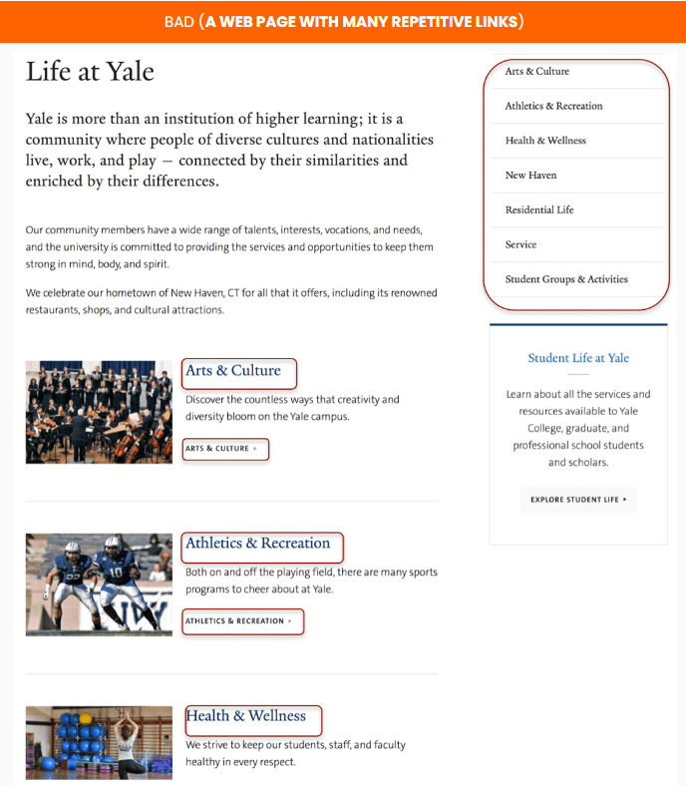
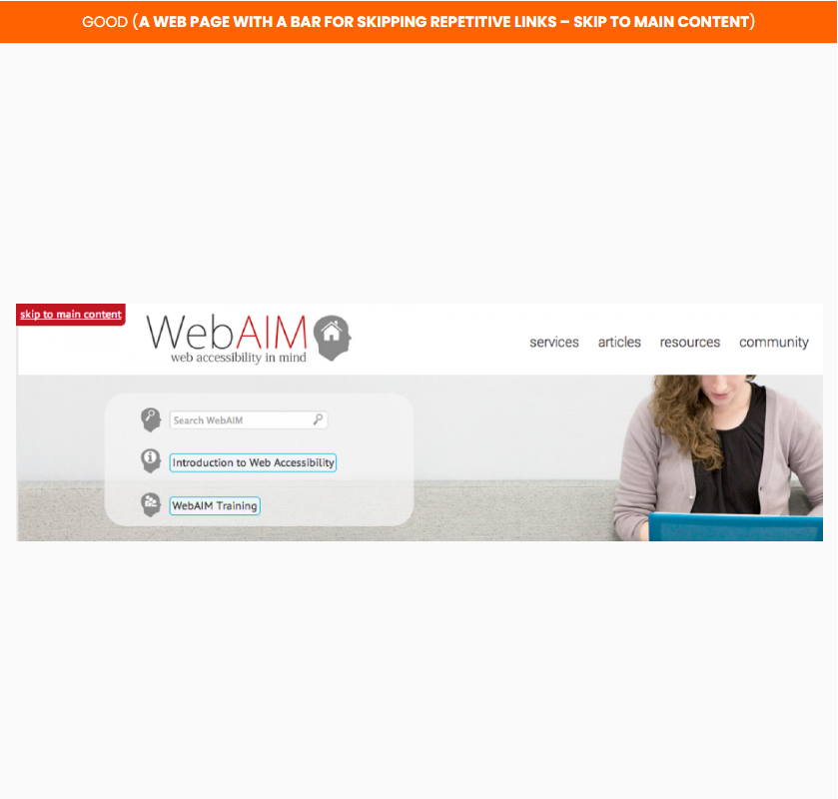
WCAG 2.1 Guidelines
2.4 Navigable - Help users to navigate, find content, and determine where they are
Case: Bypassing blocks of repetitive content
Notes:
Now, we will have look on , Guideline 2.4 Navigable.
Provide ways to help users navigate, find content, and determine where they are.
(Level A)
Provide a mechanism to bypass blocks of repetitive content on a Web page.
Ensure Web pages have titles that describe the topic or purpose.
Ensure focusable components receive focus in an order that preserves meaning and operability.
Ensure the purpose of each link can be determined from the link text alone or from the link text and the link context.

Slide 20
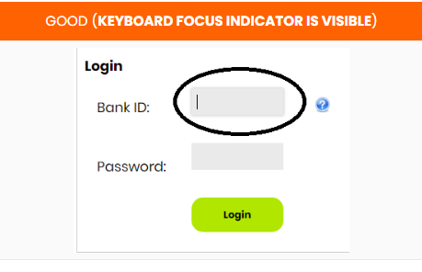
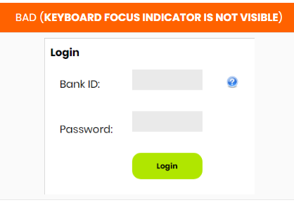
WCAG 2.1 Guidelines
2.4 Navigable - Help users to navigate, find content, and determine where they are
Case: Keyboard focus indicator
Notes:
(Level AA)
Ensure more than one way is available to locate a Web page within a set of Web pages except the Web Page is a step in a process.
Ensure headings and labels describe topic or purpose.
The keyboard operable user interface should have a mode of operation where the keyboard focus indicator is visible.

Slide 21
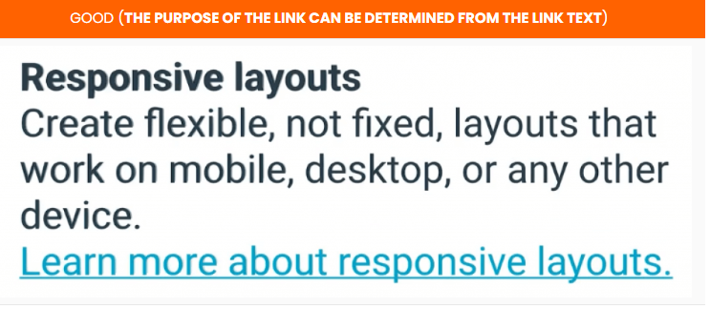
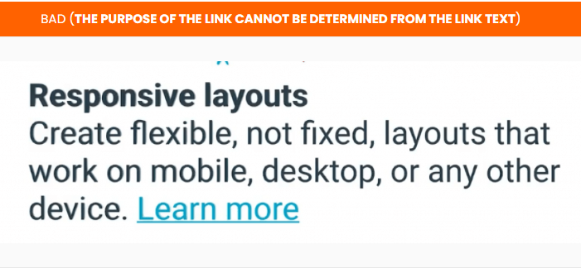
WCAG 2.1 Guidelines
2.4 Navigable - Help users to navigate, find content, and determine where they are
Case: Link text
Notes:
(Level AAA)
Ensure information about the user’s location within a set of Web pages is available.
Provide a mechanism to allow the purpose of each link to be identified from the link text alone.
Section headings should be used to organize the content.

Slide 22
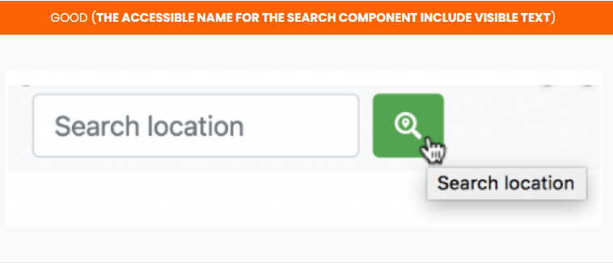
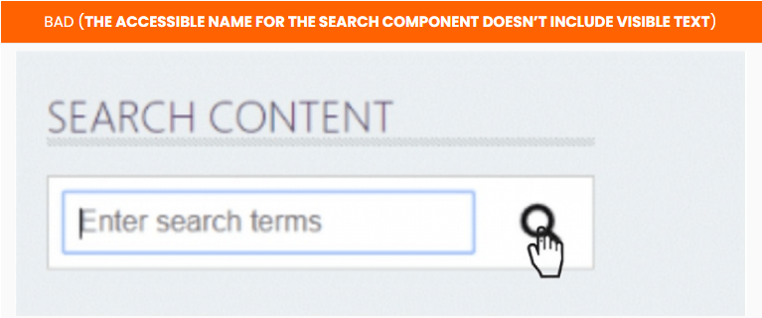
WCAG 2.1 Guidelines
2.5 Input Modalities - Make it easier for users to operate functionality through various inputs beyond keyboard
Case: Interface components with labels
Notes:
Now, we will have look on , Guideline 2.5 Input Modalities.
Make it easier for users to operate functionality through various inputs beyond the keyboard.
(Level A)
Ensure all functionality that uses multipoint for operation can be operated with a single pointer.
For functionality that can be operated using a single pointer, provide a mechanism to abort the function before or after completion.
For user interface components with labels such as text, have the text of the label at the start of the name.
Ensure user interface components can also operate functionality operated by device motion or user motion.

Slide 23
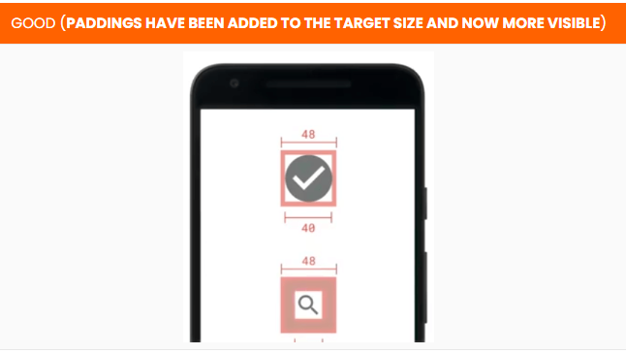
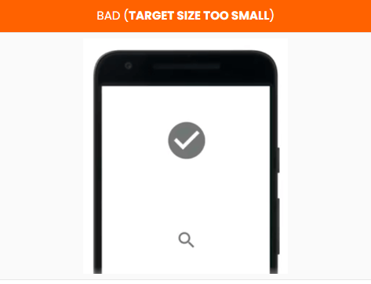
WCAG 2.1 Guidelines
2.5 Input Modalities - Make it easier for users to operate functionality through various inputs beyond keyboard
Case: Size of the target for pointer inputs
Notes:
(Level AAA)
Ensure the size of the target for pointer inputs is at least 44 by 44 CSS pixels except when in a sentence or block of text.
Ensure web content does not restrict the use of input modalities available on a platform except where the restriction is essential.

Slide 24
WCAG 2.1 Guidelines
Understandable - content and interface are understandable
Sr. No. | Context | Guideline
3.1 | Readable | Text should be readable and understandable
3.2 | Predictable | Make Web pages appear and operate in predictable ways
3.3 | Input Assistance | Help users to avoid and correct mistakes
Notes:
Information and the operation of user interface must be understandable.
Reference:
https://www.w3.org/TR/WCAG21/#understandable

Slide 25
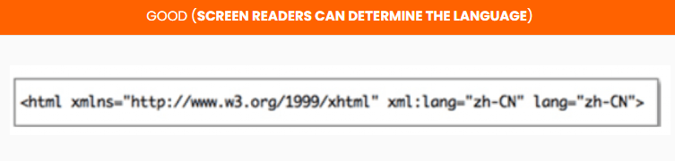
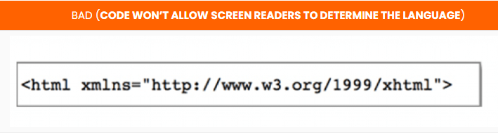
WCAG 2.1 Guidelines
3.1 Readable - Text should be readable and understandable
Case: Coding language to be programmatically determinable
Notes:
Now, we will have look on , Guideline 3.1 Readable.
Make text content readable and understandable.
(Level A)
Ensure the default human language of each Web page can be programmatically determined using the HTML lang attribute.

Slide 26
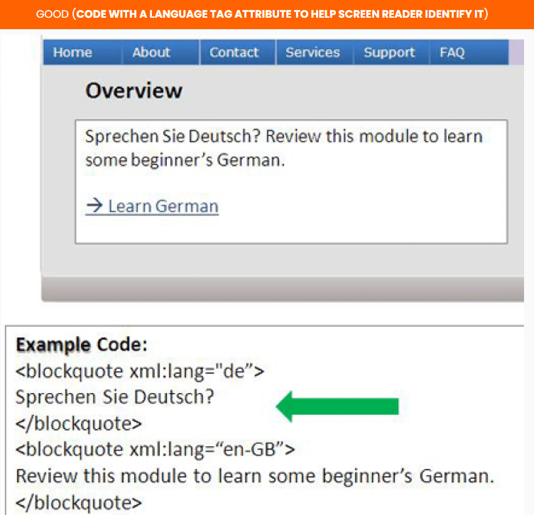
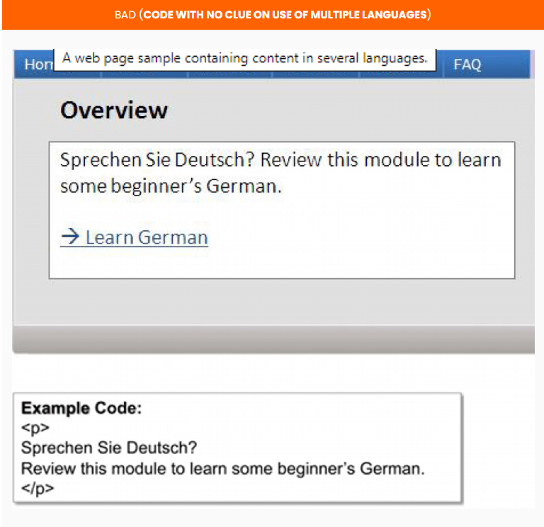
WCAG 2.1 Guidelines
3.1 Readable - Text should be readable and understandable
Case: Code with a language tag attribute
Notes:
(Level AA)
Ensure the human language of each passage or phrase in the content can be programmatically determined except for technical terms and vernacular.

Slide 27
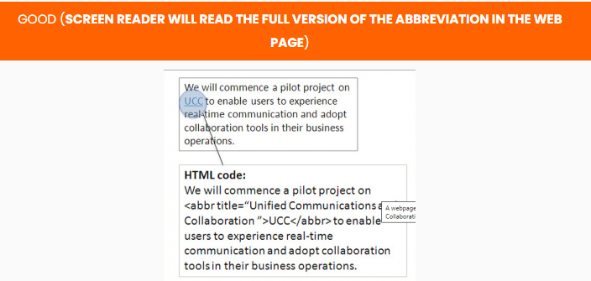
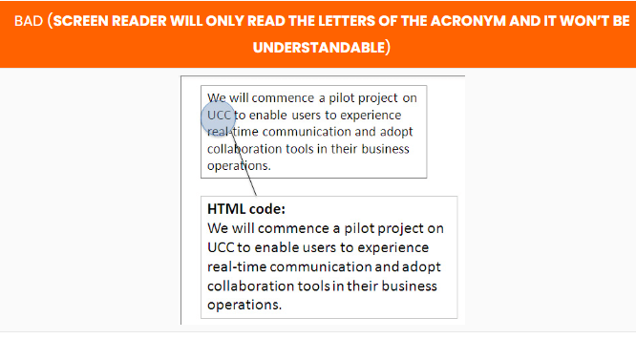
WCAG 2.1 Guidelines
3.1 Readable - Text should be readable and understandable
Case: Identifying specific abbreviations
Notes:
(Level AAA)
Provide a mechanism for identifying specific definitions of words used in an unusual way, including idioms and jargon.
Provide a mechanism for identifying the expanded form or meaning of abbreviations.
Provide supplemental content text when the text requires reading ability more advanced than the lower secondary education level.
Provide a mechanism for identifying specific pronunciation of words whose meaning, in context, is ambiguous.

Slide 28
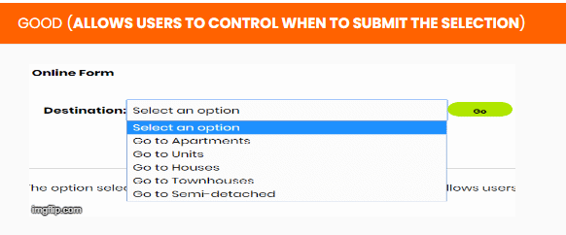
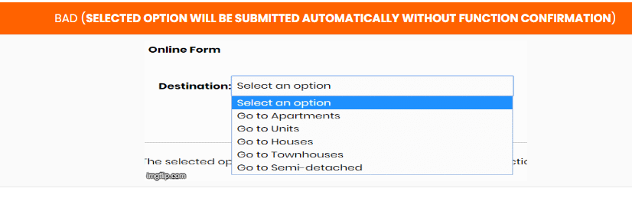
WCAG 2.1 Guidelines
3.2 Predictable - Make Web pages appear and operate in predictable ways
Case: User interface component
Notes:
Now, we will have look on , Guideline 3.2 Predictable.
Make Web pages appear and operate in predictable ways.
(Level A)
Ensure no user interface component initiate a change of context when it receives focus.
Changes made to the settings of any user interface component must not cause a change of context unless the user has been warned before using the component.

Slide 29
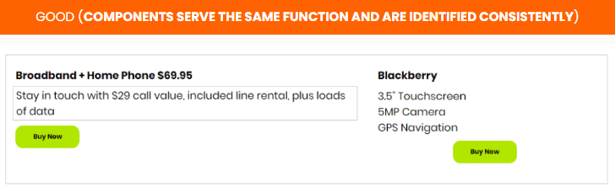
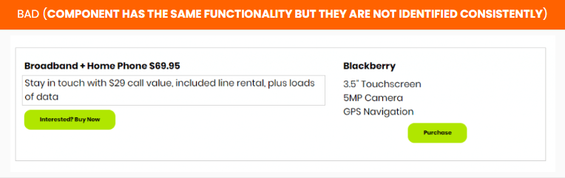
WCAG 2.1 Guidelines
3.2 Predictable - Make Web pages appear and operate in predictable ways
Case: Components functionality within a set of web pages
Notes:
(Level AA)
Ensure navigational mechanisms that are repeated on multiple Web pages occur in the same relative order, unless a change is initiated by the user.
Ensure components that have the same functionality within a set of Web pages are identified consistently.

Slide 30
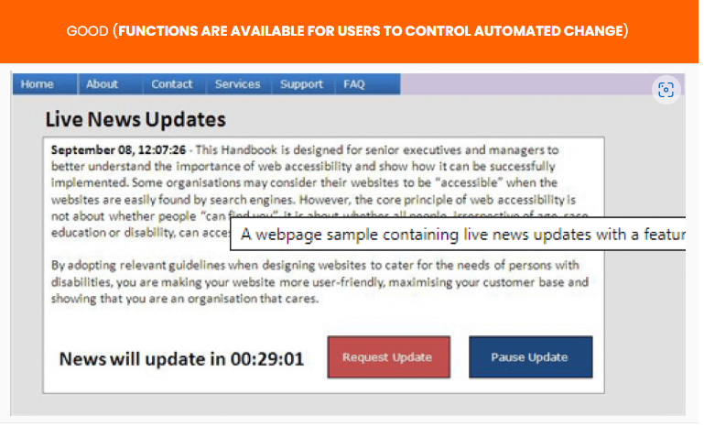
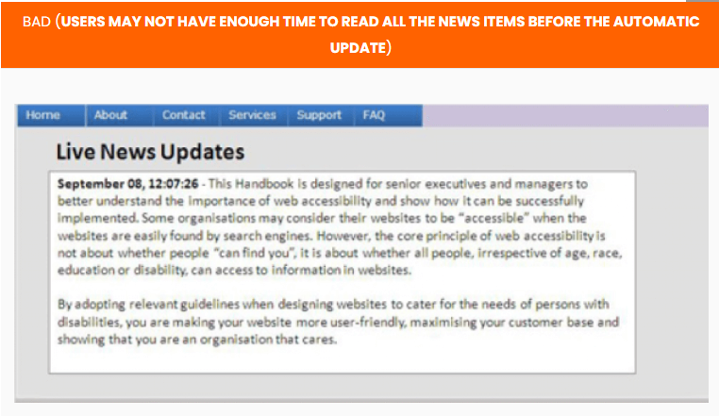
WCAG 2.1 Guidelines
3.2 Predictable - Make Web pages appear and operate in predictable ways
Case: Changes of context on a web page
Notes:
(Level AAA)
Ensure changes of context are initiated only by user request and can be turned off.

Slide 31
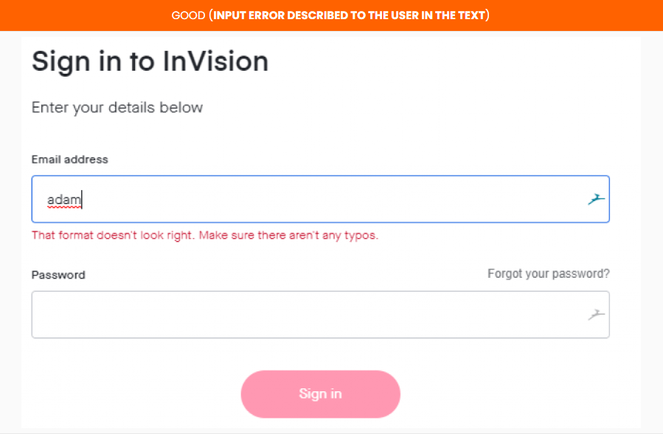
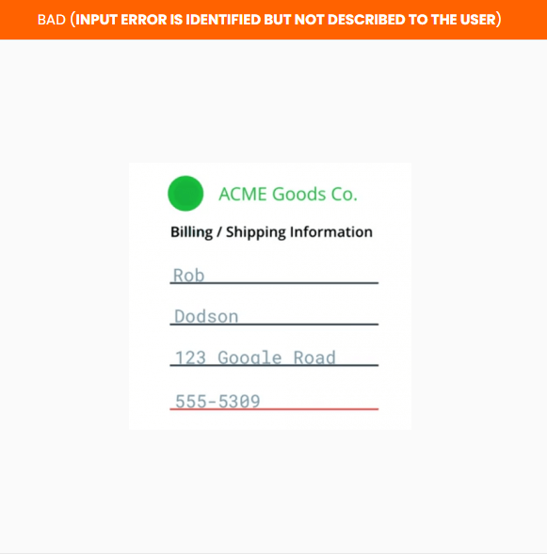
WCAG 2.1 Guidelines
3.3 Input Assistance - Help users to avoid and correct mistakes
Case: Describing input error to the user
Notes:
Now, we will have look on , Guideline 3.3 Input Assistance.
Help users avoid and correct mistakes.
(Level A)
Input error should be identified and described in the text to the user when automatically detected.
Provide labels or instructions when content requires user input.

Slide 32
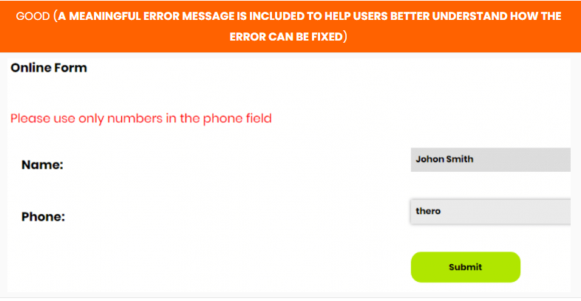
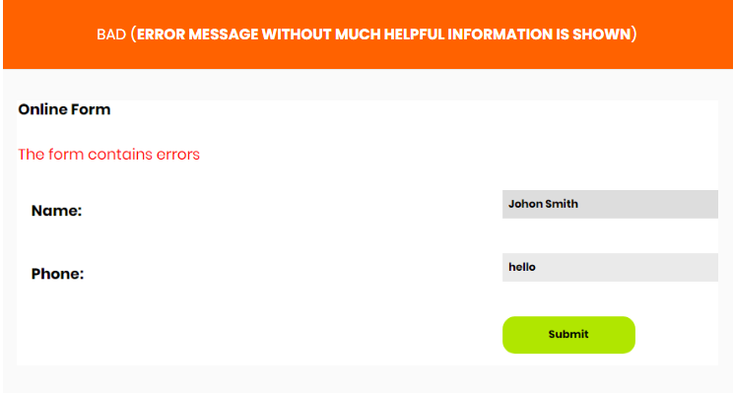
WCAG 2.1 Guidelines
3.3 Input Assistance - Help users to avoid and correct mistakes
Case: Describing input error and suggesting corrections to the user
Notes:
(Level AA)
If an input error is automatically detected and suggestions for correction are known, then it should be provided to the user.
Provide a mechanism for confirming and correcting information before finalizing the submission for Web pages that cause legal commitments or financial transactions.

Slide 33
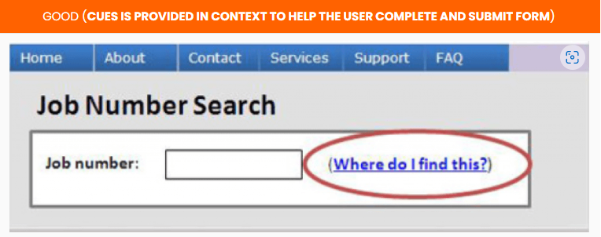

WCAG 2.1 Guidelines
3.3 Input Assistance - Help users to avoid and correct mistakes
Case: Confirming and correcting information on forms
Notes:
(Level AAA)
Ensure context-sensitive help is available.
For Web pages that require the user to submit information, provide a mechanism for confirming and correcting information before finalizing the submission.

Slide 34
WCAG 2.1 Guidelines
Robust - content can be used reliably by a wide variety of user agents, including assistive technologies
Sr. No. | Context | Guideline
4.1 | Compatible | Maximize compatibility with assistive technologies (such as screen readers) and future browsers
Notes:
Content must be robust enough that it can be interpreted by a wide variety of user agents, including assistive technologies.
Reference:
https://www.w3.org/TR/WCAG21/#robust

Slide 35


WCAG 2.1 Guidelines
4.1 Compatible - Maximize compatibility with assistive technologies (such as screen readers) and future browsers
Case: Coding interface components
Notes:
Now, we will have look on , Guideline 4.1 Compatible.
Maximize compatibility with current and future user agents, including assistive technologies.
(Level A)
For content implemented using markup languages, ensure all elements are unique, except where the specifications allow it.
For all user interface components such as form and elements links, a user should be able to programmatically determine the name and role; and also programmatically set the states and value.

Slide 36


WCAG 2.1 Guidelines
4.1 Compatible - Maximize compatibility with assistive technologies (such as screen readers) and future browsers
Case: Coding status messages
Notes:
(Level AA)
Ensure status messages can be programmatically determined through role or properties and presented to the user by assistive technologies without receiving focus.

Slide 37



WCAG 2.1 Guidelines
Guidelines
Solution Reviews
Tools Support
Notes:
https://www.whoisaccessible.com/guidelines/wcag/

Slide 38

Project Silver
a.k.a. W3C Accessibility Guidelines 3.0
Notes:
The new proposed WCAG 3.0 comes under Project Silver, which started in 2016
For this team, the first few years were spent researching WCAG 2.x to find out what problems people were having with WCAG 2.x ,so, that those issues could be well-addressed.
Project Silver later gained its official name, the W3C Accessibility Guidelines 3.0. The words “Web Content” were removed from the name because WCAG 3.0 promised to be a more all-encompassing set of guidelines for digital content, including not just web pages, but apps, virtual reality, and other devices making their way onto the internet such as smartwatches, TVs, navigation systems, and home assistants.
Some of the major changes proposed from WCAG 2.x were the following:
Make it easier to learn and understand the guidelines.
Allow different types of guidelines to support more disability needs.
Provide more flexibility for the guidelines to keep up with new technologies.
Have conformance to guidelines better reflect real-world accessibility, including making allowances for bugs and other low-impact issues.
There seem to be just as many people in hopeful anticipation of WCAG 3.0, as there are those who are worried it may undo some of the progress made by WCAG 2.x. WCAG 3.0 is guaranteed to shake up the accessibility industry as much as, if not more than WCAG 2.0 did when it first came out. Many things got far more complicated than they had been in WCAG 1.0.
The W3C is aiming to publish a candidate recommendation of WCAG 3.0 sometime in 2022 and the final publication of WCAG 3.0 is expected somewhere at the end of 2023

Slide 39

We Are VVnT Team
Notes:
So with this , we have come to the end of this video . We hope you guys find it informative and helpful.
Thanks for watching .

Slide 40
VVnT supports
#WeAllFitIn Campaign

